Slide 1
DATA DRIVEN PROPOSALs TO INCREASE SALES REVENUE
Presentation to CTO, Mr (NAME REMOVED)
Due date: 06/06/2023, 11am Tues
Overview
Introduction
Analysis - Traffic mediums
Analysis – Transactional process
Analysis – View to Buy ratios
Recommendations
Limitations, errors & constraints
Summary & Questions
These sections will demonstrate my thought process and my findings
By Ryan Richardson

Slide 2
Introduction
Dataset name: ga4_obfuscated_sample_ecommerce
Date range: Nov 2020 – Jan 2021
Limitations - Dataset does not include:
Refunds
Production costs
CPA data
Noteworthy comments
Highly turbulent timeframe to analyse:
01/11/2020 – 31/01/2021 – 3 months over Xmas
During COVID lockdown period
Topic choice
Researching (COMPANY NAME NAME REMOVED) identified challenges such as search engine censorship. This focused my initial analysis on traffic

Slide 3

Analysis - Traffic Origins
Traffic origins – ( dataset calls this a medium: traffic_source.medium )
Right: Traffic origin sorted by mean revenue per view in USD
Left: Percentage of views by traffic origin
Traffic origin | Total Views | Total Revenue USD | Revenue per view | views2purchase %
Referral | 536604 | 83483 | 0.16 | 10.18
UNKNOWN | 625757 | 85942 | 0.14 | 10.09
Direct | 620820 | 79640 | 0.13 | 8.25
Organic | 863219 | 103977 | 0.12 | 7.17
Paid search (CPC) | 101846 | 9068 | 0.09 | 6.41
Note: Referrals account for 19% views but
Highest revenue per view
1
2
(Coupled with session id)

Slide 4
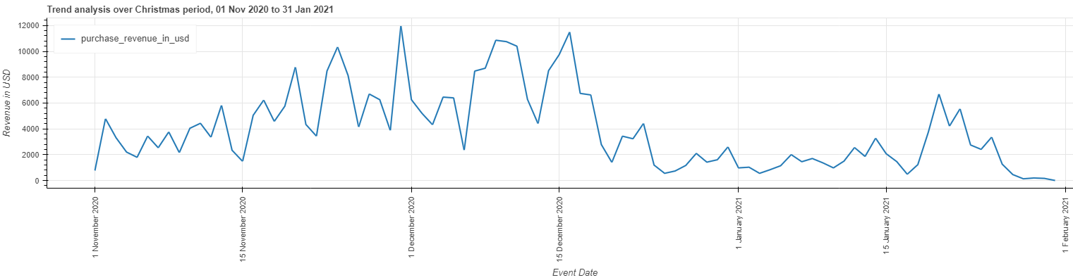
Analysis – transaction process
Regarding views leading to purchases, what happens if we break down the transaction process into stages and ask “frequency of a view lead to item being added to the basket?”. The disparity is quite interesting. Similarly for the percentage of “add to basket” events leading to a purchase
What’s causing people to change their mind?
Is there an issue with UX or design that’s frustrating the consumer?
For each stage, what can be done to increase these percentages?
Medium | Revenue per View | views2purchase % | views2cart % | cart2purchase %
Referral | 0.16 | 10.18 | 26.82 | 37.94
UNKNOWN | 0.14 | 10.09 | 27.85 | 36.22
Direct | 0.13 | 8.25 | 26.11 | 31.58
Organic | 0.12 | 7.17 | 24.46 | 29.33
Paid search (CPC) | 0.09 | 6.41 | 23.65 | 27.09
Can the average transaction revenue be increased?
Transaction ID | Total Item QTY | Unique Item QTY | Revenue USD
886501 | 1 | 1 | 10
274132 | 4 | 1 | 192
… | … | … | …
Mean item qty: 4.662337662337662
Mean unique qty: 3.170398566950291
Mean revenue: 73.96954769368563
Proof of earlier comment
that this dataset is a turbulent
Timeframe to analyse

Slide 5
Analysis – View:Buy ratios
Continuing the theme of view to purchase ratios, I decided to explore this at the ‘per item’ level
Which products have the highest chance of being brought if viewed?
How to increase the unique views & unique buys?
Which products return the greatest revenue?
How to increase the View:Buy ratio?
Can we leverage the exposure of high revenue products to increase sales of the high view:buy ratio products and vice versa?
Anomalies / worthy mentions:
Gift cards have a high revenue & high View:Buy ratio, how can we use this to increase sales?
What’s happening with “Google F/C Longsleeve Charcoal”? Why is it at 0 unique views yet High revenue? Error in data warehouse? Promotion?
Item Name | Unique Views | Unique Buys | Total Revenue $ | View:Buy Ratio |  | Item Name | Unique Views | Unique Buys | Total Revenue $ | View:Buy Ratio
Google Emoji Magnet Set | 159 | 38 | 376 | 0.28 |  | Google Zip Hoodie F/C | 49795 | 256 | 13788 | 0.02
Google Keychain | 340 | 71 | 657 | 0.26 |  | Google Crewneck Sweatshirt Navy | 32271 | 225 | 10714 | 0.02
Google PNW Campus Mug | 468 | 59 | 704 | 0.23 |  | Google Men's Tech Fleece Grey | 17371 | 123 | 9965 | 0.02
Google Seattle Campus Mug | 522 | 64 | 793 | 0.22 |  | Google Badge Heavyweight Pullover Black | 33602 | 184 | 9712 | 0.02
Google Austin Campus Mug | 625 | 81 | 871 | 0.22 |  | Super G Unisex Joggers | 52758 | 285 | 9529 | 0.02
Google SF Campus Tote | 208 | 37 | 400 | 0.22 |  | Google Crewneck Sweatshirt Green | 28084 | 177 | 8382 | 0.02
Google Kirkland Campus Tee | 151 | 22 | 424 | 0.21 |  | Google Sherpa Zip Hoodie Charcoal | 32219 | 105 | 6397 | 0.01
Google Chicago Campus Mug | 524 | 62 | 556 | 0.2 |  | Google Men's Puff Jacket Black | 11405 | 63 | 6187 | 0.02
Google Lapel Pin | 276 | 41 | 302 | 0.19 |  | Google Men's Tech Fleece Vest Charcoal | 4328 | 77 | 5549 | 0.04
Google Blue YoYo | 155 | 23 | 113 | 0.19 |  | Google Women's Puff Jacket Black | 13860 | 56 | 5313 | 0.01
Google LA Campus Mug | 487 | 57 | 463 | 0.18 |  | Google Canteen Bottle Black | 6436 | 144 | 5303 | 0.05
Google Boulder Campus Tote | 51 | 6 | 36 | 0.17 |  | Google Utility BackPack | 13001 | 52 | 5256 | 0.01
Gift Card - $25.00 | 82 | 42 | 1125 | 0.17 |  | Android Iconic Crewneck Sweatshirt | 19912 | 108 | 5159 | 0.01
Google LA Campus Tee | 389 | 40 | 650 | 0.16 |  | Google Sherpa Zip Hoodie Navy | 18169 | 85 | 4897 | 0.01
Google LA Campus Tote | 123 | 15 | 106 | 0.16 |  | Google Black Cloud Zip Hoodie | 2836 | 66 | 4681 | 0.05
Google Boulder Campus Mug | 356 | 35 | 283 | 0.16 |  | Google F/C Longsleeve Charcoal | 0 | 164 | 4548 | 0

Slide 6
Recommendations
Analysis – Traffic mediums
Referrals have the highest revenue per view but only account for 19% of total views. If this percentage increases then overall revenue should also increase
Stop investing in paid searches and emphasis on referral related ads or campaigns, especially if organic traffic is stunted by google censorship or ASA ad bans
Investment in sponsorship of relevant influencers, (YouTube, TikTok, Instagram)
Consider low production cost merchandise that can leverages ad campaigns
For example, (company ad campaign that made the news mentioned here) tshirt & hoodie
Analysis – Transaction process
Different stages of the transaction process have different percentages of user engagement.
Unregistered users / logged out users
Offers & Incentives for new registrations, incentivise current users to engage
Items left in basket / unfinished checkout process
Explore reminder processes. Email / notification on next logon
Checkout Screen:
Additional offers / amazon-like “users that brought this also brought…”
Warranty extensions for higher value products or coupons for future purchases
Monthly subscription services – consumable top-ups. Some sites even do clothing, like a new pair of boxers every month
Customer Research UX, design to identify any processes that frustrate the customer and prevent them from completing transaction
Analysis – View:Buy ratios
Some products have a higher purchase rate if viewed. Requires further research. Is it due to a small sample size or is this a trend? If it’s a trend I would recommend researching why as it may suggests options for expanding product lines.
Pair visibility of highly viewed products with high revenue per view products (and vice versa) by including them on respective product page or adding incentives (if you buy this product get a X% discount for another)
Increase visibility & marketing of gift cards

Slide 7
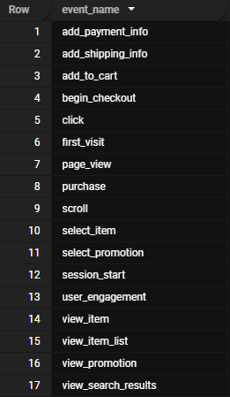
Limitations, errors, Constraints
Ingestion limitations
Lack of production & logistic cost data
Lack of CPA data – more data for traffic sources
Lack of refund data - (possible error in warehouse ingestion schema)
All values are null, might this suggest an error
List of event names
With more time:
Further exploration of event_name data. (List to left)
Use view_search_results to analyse search terms and click throughs. Use combination of ML and NLP with python to predict search category to analyse search trends
Explore begin_checkout to understand percentage of people who complete checkout. Check UX processes that cause frustration and lose sales
Explore user_engagement & page_view to see which areas of the site has top engagement
More in depth trend analysis of previous topics, especially over steady time periods that are not so unprecedented
With more data:
More profit based analysis
With more data on production costs I could offer insights into which products are making more profit / loss
More refund analysis
Are some products being refunded more than others? Why?

Slide 8



Thanks for listening!
Summary & Questions
Suggestion 1.1: Explore methods that increase referral traffic
Suggestion 2.1: Research UX design during checkout process
Suggestion 2.2: Incentivise additional purchases to increase average transaction revenue
Suggestion 3.1: Research products with higher view:buy ratios
Suggestion 3.2: Increase gift card visibility & marketing
Questions?

